Slide 1
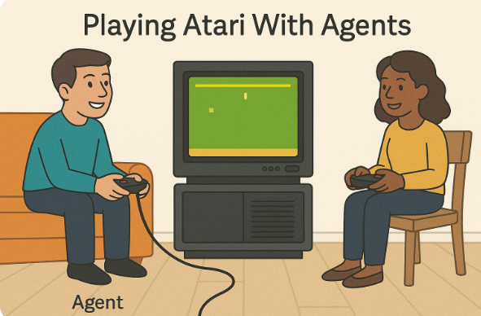
Playing Attari With Agents
By – Aditya Bhatt

Slide 2
What is Atari?
🕹️ Atari (in this RL context) refers to:
A collection of classic arcade video games originally created by the company Atari Inc. in the 1970s–80s. Some examples:
Pong (table-tennis-like game)
Breakout (brick-breaking game)
Space Invaders
Enduro
Seaquest

Slide 3
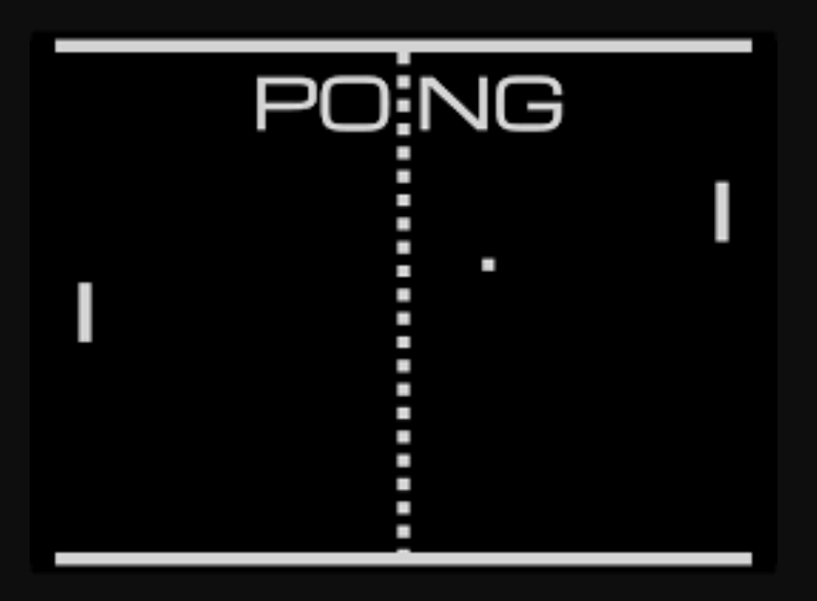
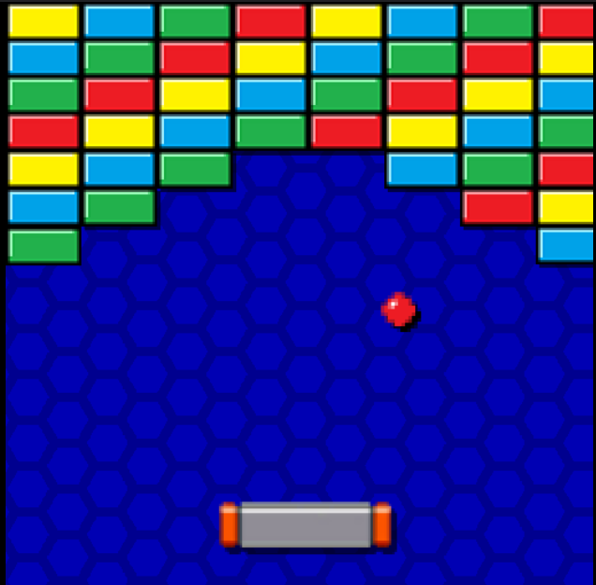
PONG
BRICK BREAKER

Slide 4
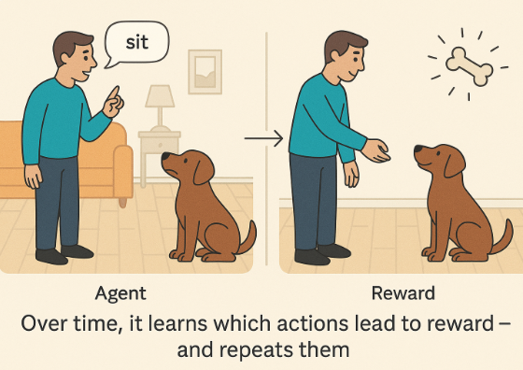
What is Reinforcement Learning (RL)?
Reinforcement Learning is a type of machine learning where an agent learns to take actions in an environment to maximize reward over time.
🧠 Think of RL like training a dog:
You say “sit” → dog tries something → maybe it sits
If it sits → 🦴 reward
If not → 😐 nothing happens
Over time, it learns which actions lead to reward — and repeats them
In RL, the dog is the agent, your room is the environment, and the reward is feedback that teaches it what’s good.

Slide 5
Why RL? (Now?)
LLMs generate text… but how do we teach them what kind of text is better?
Enter RLHF — Reinforcement Learning from Human Feedback.
What happens:
LLM writes a response.
A human (or another model) gives a preference score or ranking.
RL is used to tune the model so it writes more preferred responses.
This RL process:
Makes ChatGPT more helpful
Makes Claude more harmless
Makes LLMs more aligned to us

Slide 6
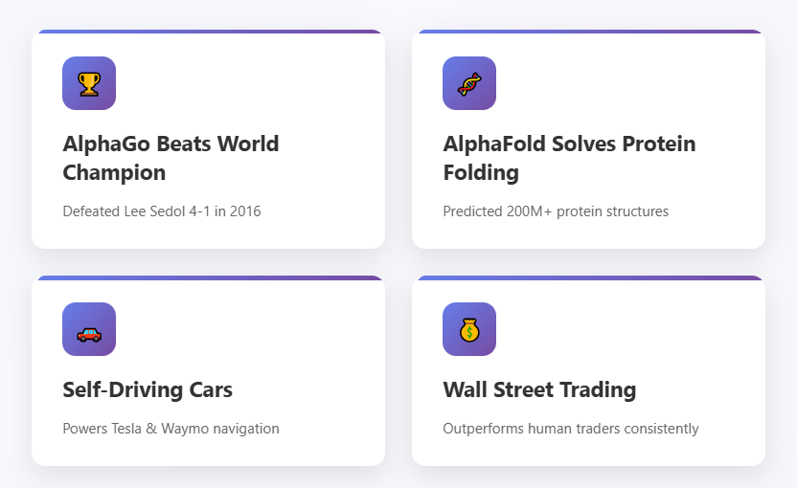
RL IS NO HYPE

Slide 7
Basic’s Of RL
🔹 1. Agent: The decision-maker
→ This could be your DQN or even a dog. It chooses an action based on what it sees.
🔹 2. Environment: The world the agent lives in
→ It could be Pong, a robot simulator, or even the stock market.
🔹 3. State (s): What the agent sees
→ E.g., a screenshot of Pong or the robot’s position.
🔹 4. Action (a): What the agent does
→ E.g., move paddle UP or DOWN.
🔹 5. Reward (r): A signal that tells the agent how good that action was
→ +1 if you score in Pong, -1 if you miss.
🔹 6. Next state (s′): What happens after the action
→ The game advances, a new frame is shown.
🧠 Goal of RL:
This learning happens as the loop is repeated millions of times during training.

Slide 8
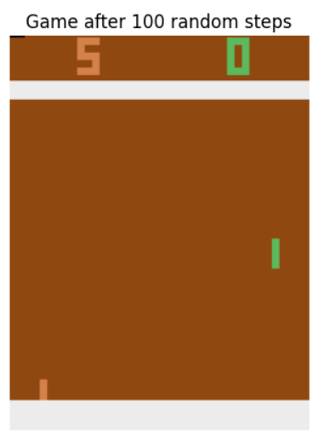
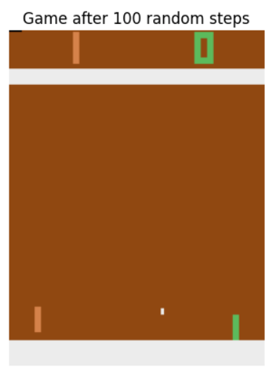
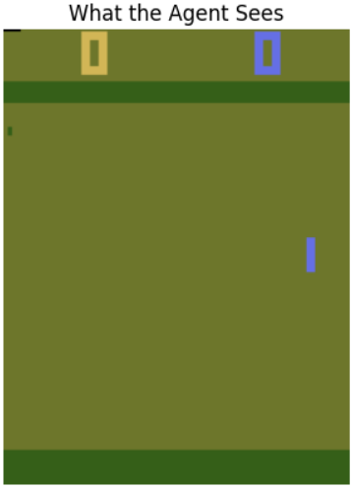
Environment Setup
The game screen is made of 210 rows (top to bottom)
Each row has 160 columns (left to right)
Each position [y, x] holds an RGB pixel:
Red intensity: 0–255
Green intensity: 0–255
Blue intensity: 0–255

Slide 9
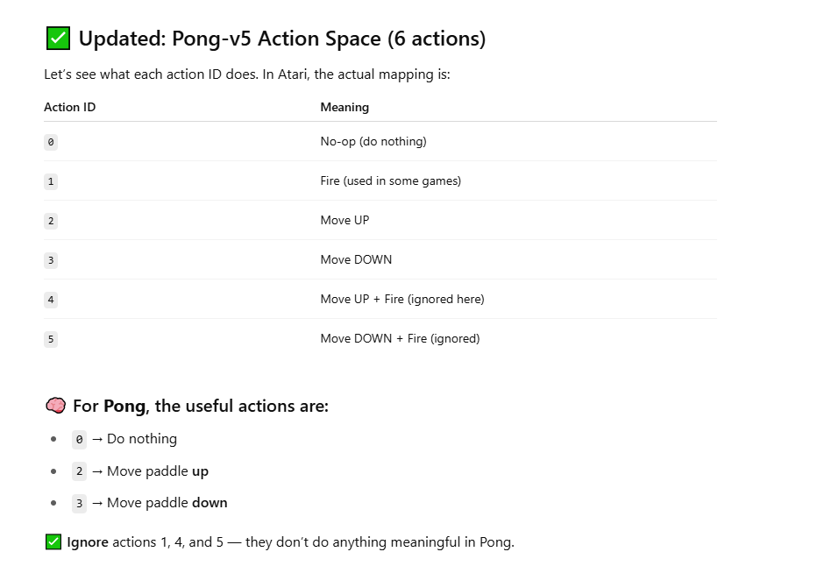
What Actions Agent can take?

Slide 10
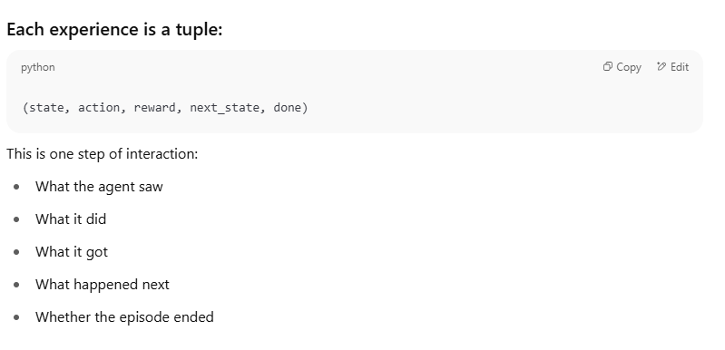
Store this experience for learning
🧠 Why?
The agent learns not immediately, but by storing each experience and then training on it later. This experience is stored in what’s called : Replay Buffer or Experience Memory

Slide 11
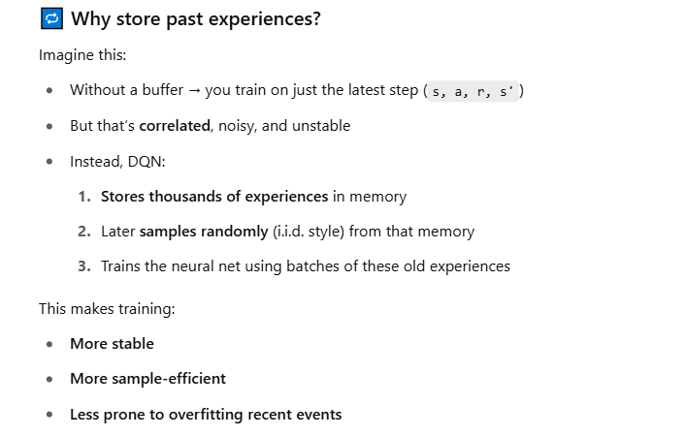
Why storing experience helps?

Slide 12
DQN = Deep Q-Network It combines Q-Learning with a neural network to learn how to act in complex environments like Pong.
“The Q-network learns by predicting its own future — it bootstraps intelligence from reward and recursion.”

Slide 13
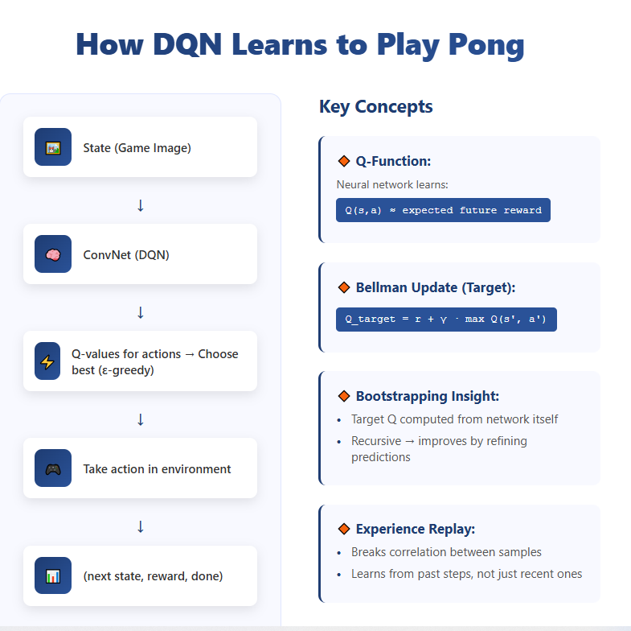

Slide 14
Image Processing

Slide 15
Training a Neural Net

Slide 16
Production Neural Network

Slide 17
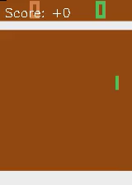
Results

Slide 18
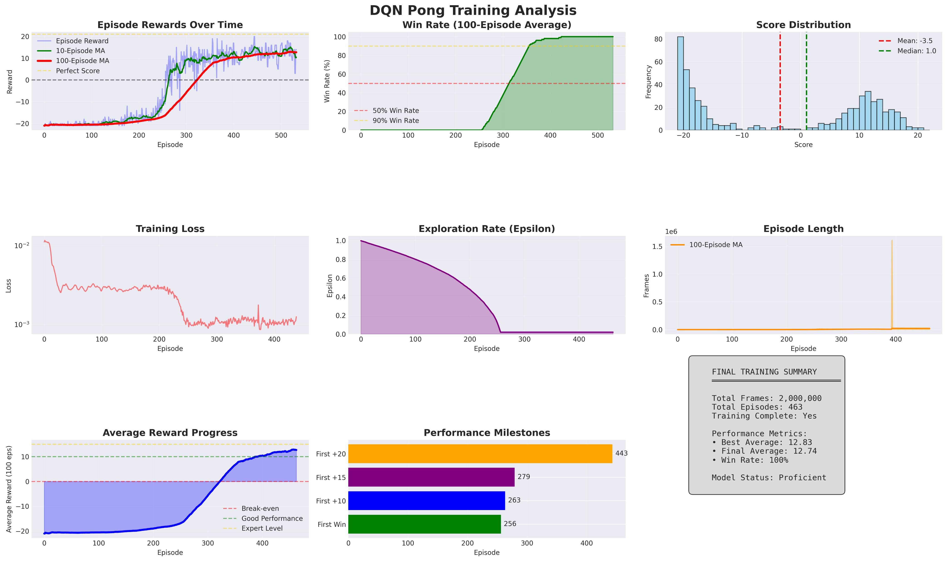
Analysis

Slide 19
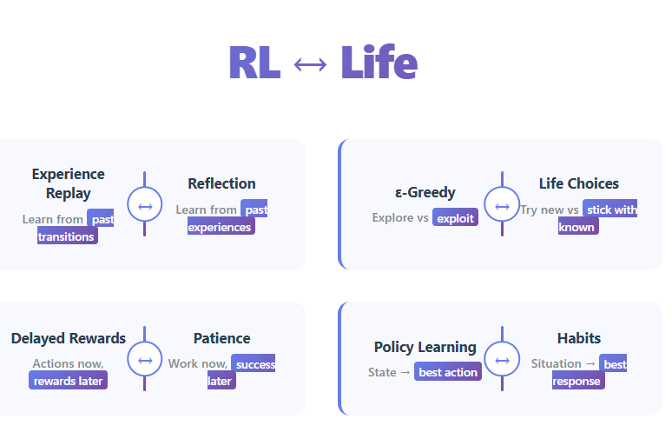
Final Comments

